Slide 1
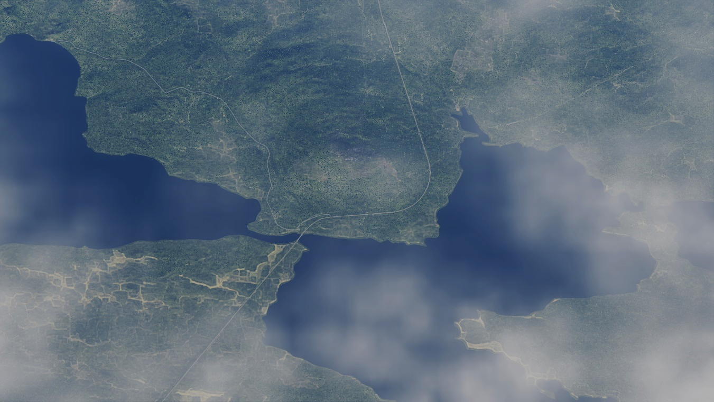
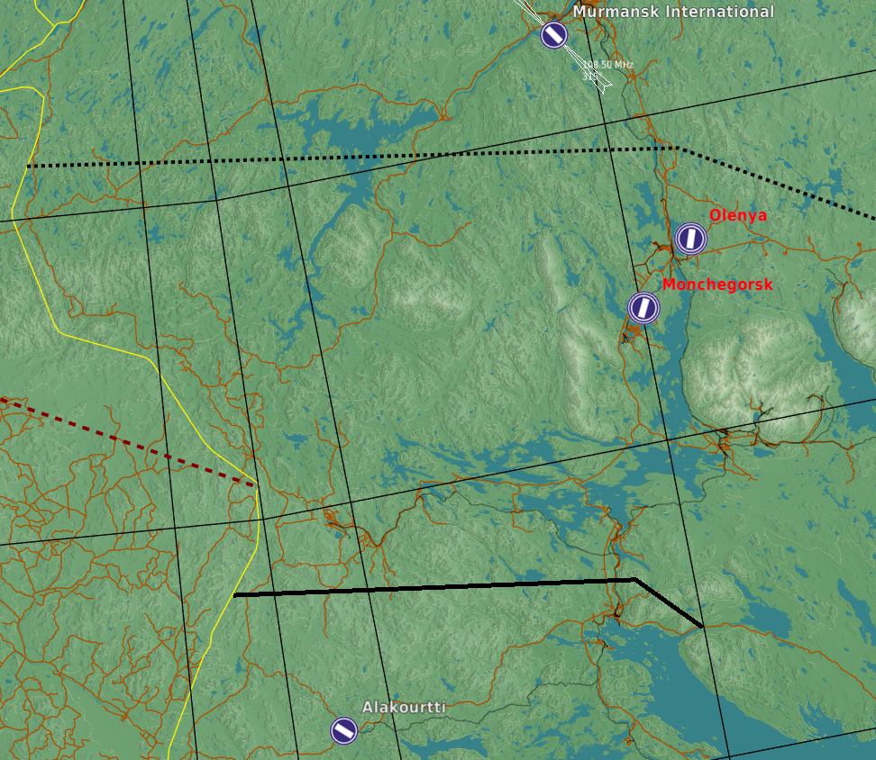


SRNTGT058 R-21 Highway Bridge E105
N
BE ADVISED! WATER TARGET – BUT NOT SEA LEVEL! – 440 FT
SRNTGT058A
1
DESCRIPTION OF THE DESIRED POINTS OF IMPACT WITH WPN TYPE:
SRNTGT058A - PILLAR
DPI1 N 67°37.426’ E033°42.682’ / 440 ft / (500 Ibs bomb)

